Slide 1

“All your layer are belong to us”
Attacking Automatic Wireless Network Selection
Dino A. Dai Zovi and Shane A. Macaulay
{ddaizovi,smacaulay1}@bloomberg.com

Slide 2

Agenda
Windows XP Wireless Auto Configuration (WZCSVC)
Attacking Wireless Auto Configuration
Mac OS X AirPort
KARMA: Wireless Client Attack Toolkit
Demo
  All your layer are belong to us

Slide 3
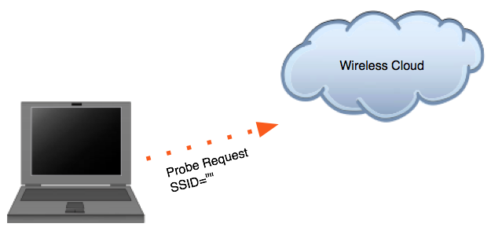
Wireless Auto Configuration Algorithm
First, Client builds list of available networks
  Send broadcast Probe Request on each channel

Slide 4
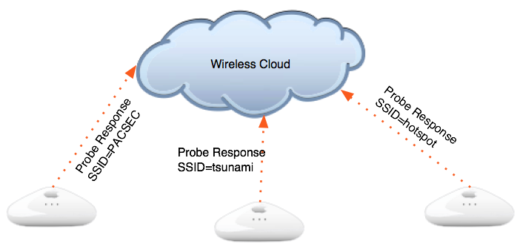
Wireless Auto Configuration Algorithm
Access Points within range respond with Probe Responses

Slide 5
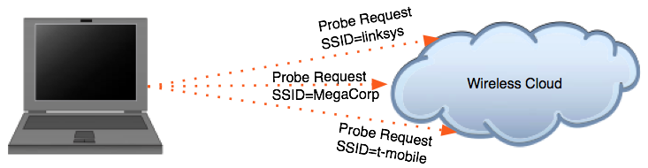
Wireless Auto Configuration Algorithm
If Probe Responses are received for networks in preferred networks list:
  Connect to them in preferred networks list order
Otherwise, if no available networks match preferred networks:
  Specific Probe Requests are sent for each preferred network in case networks are “hidden”

Slide 6

Wireless Auto Configuration Algorithm
If still not associated and there is an ad-hoc network in preferred networks list, create the network and become first node
  Use self-assigned IP address (169.254.Y.Z)

Slide 7
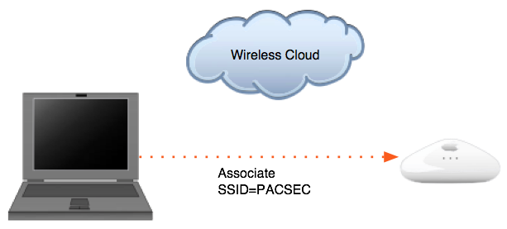
Wireless Auto Configuration Algorithm
Finally, if “Automatically connect to non-preferred networks” is enabled (disabled by default), connect to networks in order they were detected
Otherwise, wait for user to select a network or preferred network to appear
  Set card’s SSID to random 32-char value, Sleep for minute, and then restart algorithm

Slide 8
Attacking Wireless Auto Configuration
Attacker spoofs disassociation frame to victim
Client sends broadcast and specific Probe Requests again
  Attacker discovers networks in Preferred Networks list (e.g. linksys, MegaCorp, t-mobile)

Slide 9
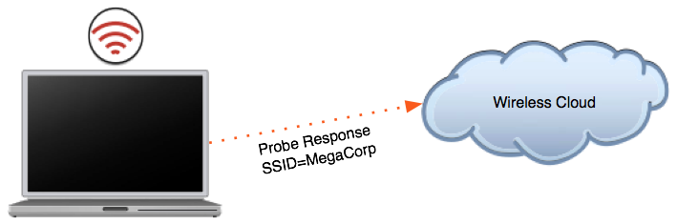
Attacking Wireless Auto Configuration
Attacker creates a rogue access point with SSID MegaCorp

Slide 10
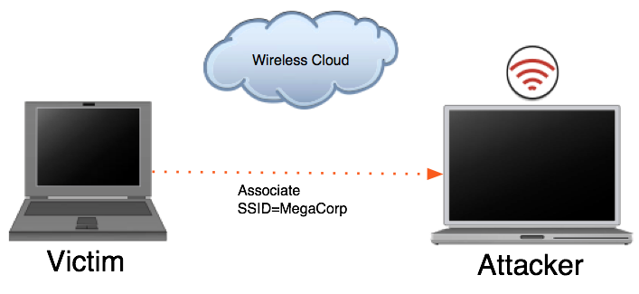
Attacking Wireless Auto Configuration
Victim associates to attacker’s fake network
  Even if preferred network was WEP (XP SP 0)
Attacker can supply DHCP, DNS, …, servers

Slide 11
Wireless Auto Configuration Attacks
Join ad-hoc network created by target
  Sniff network to discover self-assigned IP (169.254.Y.Z) and attack
Create a more Preferred Network
  Spoof disassociation frames to cause clients to restart scanning process
  Sniff Probe Requests to discover Preferred Networks
  Create a network with SSID from Probe Request
Create a stronger signal for currently associated network
  While associated to a network, clients sent Probe Requests for same network to look for stronger signal

Slide 12
Wireless Auto Configuration 0day
Remember how SSID is set to random value?
The card sends out Probe Requests for it
We respond w/ Probe Response
Card associates
Host brings interface up, DHCPs an address, etc.
Verified on Windows XP SP2 w/ PrismII and Orinoco (Hermes) cards
Fixed in Longhorn

Slide 13
Packet trace of Windows XP associating using random SSID
00:49:04.007115 BSSID:ff:ff:ff:ff:ff:ff DA:ff:ff:ff:ff:ff:ff SA:00:e0:29:91:8e:fd Probe Request (^J^S^V^K^U^L^R^E^H^V^U...) [1.0* 2.0* 5.5* 11.0* Mbit]
00:49:04.008125 BSSID:00:05:4e:43:81:e8 DA:00:e0:29:91:8e:fd SA:00:05:4e:43:81:e8 Probe Response (^J^S^V^K^U^L^R^E^H^V^U...) [1.0* 2.0* 5.5 11.0 Mbit] CH: 1
00:49:04.336328 BSSID:00:05:4e:43:81:e8 DA:00:05:4e:43:81:e8 SA:00:e0:29:91:8e:fd Authentication (Open System)-1: Succesful
00:49:04.337052 BSSID:00:05:4e:43:81:e8 DA:00:e0:29:91:8e:fd SA:00:05:4e:43:81:e8 Authentication (Open System)-2:
00:49:04.338102 BSSID:00:05:4e:43:81:e8 DA:00:05:4e:43:81:e8 SA:00:e0:29:91:8e:fd Assoc Request (^J^S^V^K^U^L^R^E^H^V^U...) [1.0* 2.0* 5.5* 11.0* Mbit]
00:49:04.338856 BSSID:00:05:4e:43:81:e8 DA:00:e0:29:91:8e:fd SA:00:05:4e:43:81:e8 Assoc Response AID(1) :: Succesful

Slide 14
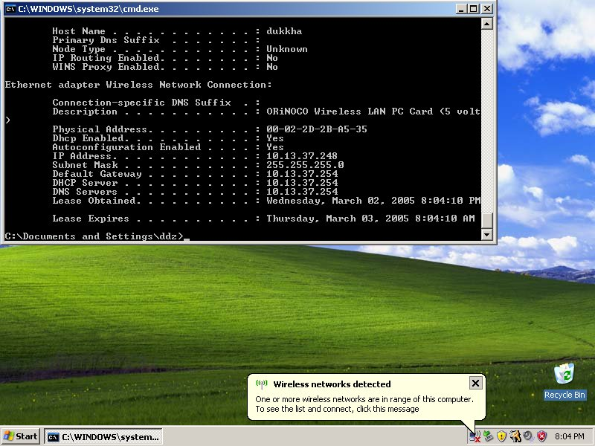
“First of all, there is no ‘we’…”

Slide 15
Vulnerable PNL Configurations
If there are no networks in the Preferred Networks List, random SSID will be joined
If all networks in PNL are encrypted, random SSID will have left-over WEP configuration (attacker will have to guess key)
  We supply the challenge, victim replies with challenge XOR RC4 keystream
  Our challenge is 000000000000000000…
  We get first 144 bytes of keystream
If there are any unencrypted networks in PNL, host will associate to KARMA Access Point.

Slide 16
How do you like them Apples?
MacOS X AirPort (but not AirPort Extreme) has similar issues
MacOS X maintains list of trusted wireless networks
  User can’t edit it, it’s an XML file base64-encoded in another XML file
When user logs in or system wakes from sleep, a probe is sent for each network
  Only sent once, list isn’t continuously sent out
  Attacker has less of a chance of observing it
If none are found, card’s SSID is set to a dynamic SSID
  With 40-bit WEP enabled
  … but to a static key
After waking from sleep, SSID is set to “dummy SSID”
  Will associate as plaintext or 40-bit WEP with above key
MacOS X 10.4 (“Tiger”) apparently has GUI to edit list of trusted wireless networks

Slide 17
A Tool to Automate the Attack
Track clients by MAC address
  Identify state: scanning/associated
  Record preferred networks by capturing Probe Requests
  Display signal strength of packets from client
Target specific clients and create a network they will automatically associate to
Compromise client and let them rejoin original network
  Connect back out over Internet to attacker
  Launch worm inside corporate network
  Etc.
“Kismet” for wireless clients

Slide 18
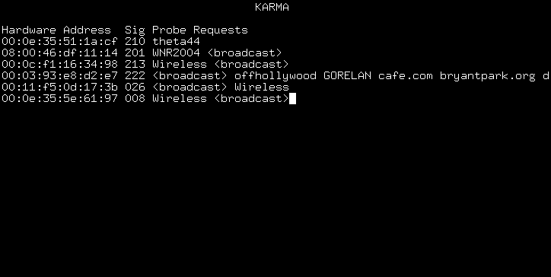
KARMA Attacks Radioed Machines Automatically

Slide 19
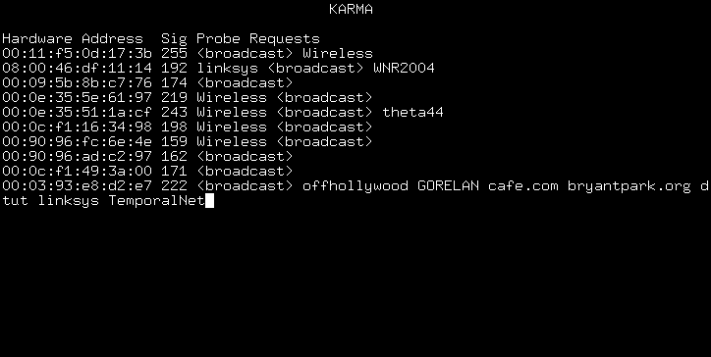
More Dirty Pictures…
A few minutes later…

Slide 20
L1: Creating An ALL SSIDs Network
Can we attack multiple clients at once?
Want a network that responds to Probe Requests for any SSID
PrismII HostAP mode handles Probe Requests in firmware, doesn’t pass them to driver
Atheros has no firmware, and HAL has been reverse engineered for a fully open-source “firmware” capable of Monitor mode, Host AP
This is where it gets interesting…

Slide 21
L2: Creating a FishNet
Want a network where we can observe clients in a “fishbowl” environment
Once victims associate to wireless network, will acquire a DHCP address
We run our own DHCP server
  We are also the DNS server and router

Slide 22
FishNet Services
When wireless link becomes active, client software activates and attempts to connect, reconnect, etc. without requiring user action
Our custom DNS server replies with our IP address for every query
We also run “trap” web, mail, chat services
  Fingerprint client software versions
  Steal credentials
  Exploit client-side application vulnerabilities

Slide 23
Fingerprinting FishNet Clients
Automatic DNS queries
  wpad.domain -> Windows
  _isatap -> Windows XP SP 0
  isatap.domain -> Windows XP SP 1
  teredo.ipv6.microsoft.com -> XP SP 2
Automatic HTTP Requests
  windowsupdate.com, etc.
  User-Agent String reveals OS version
Passive OS fingerprinting (p0f)
DNS queries reveal Windows Domain membership (redmond.corp.microsoft.com, anyone?)

Slide 24
L5: Exploiting FishNet Clients
Fake services steal credentials
  Mail and chat protocols (IMAP, POP3, AIM, YIM, MSN)
  Reject authentication attempts using non-cleartext commands
  Many clients automatically resort to cleartext when non-cleartext is not supported
  Attack VPN clients

Slide 25
Transparent HTTP Proxy Exploit Server
Acts as transparent proxy based on HTTP Host header
Exploits mounted as servlets on “Karma” virtual host
Redirections to exploits are injected into proxied content
  Insert hidden frame, window, etc.
  Can infect existing Java class files with LiveConnect exploit

Slide 26
Client-Side Exploits
Recent client-side vulnerabilities
  Microsoft JPG Processing (GDI+)
  Internet Explorer Animated Cursors Vuln
  Sun Java Plugin LiveConnect Arbitrary Package Access (Windows, Linux, MacOS X)
  …
Exploits can make use of fingerprinting info to target attack

Slide 27
Attacking Application Auto Updates
No supported interface
  Lack of consistency causes home-brew solutions
    API or protocol for doing this?
    (Un)signed CAB? ZIP? EXE? Infinite Monkey Protocol
    Implementation weaknesses
  Confused user
    Assumes “Windows Update” updates their computer’s software

Slide 28
Boron Client-Side Agent
Payloads in client-side exploits install semi-persistent agent
Monitors networks host connects to
  Host is inherently mobile, agent takes advantage of this
  Examines network configuration (domain, trust relationships, etc.)
Periodically phones home
  HTTPS through configured proxy
  DNS
Reports networks user connected to
  Detect laptop mobility policy violations

Slide 29
DEMO

